Slide 1
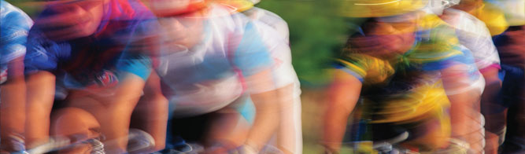
Chicago Divvy Bikes
2017 Operating Report
DevUp Project Part 1- Mackenzie Bogiages

Slide 2
Agenda
Topic
Introduction and Problem Statement Methods and Exploratory Analysis Most Popular Stations Average Trip Duration Most Popular Routes Rider Performance Most Used Bicycle Predictive Model

Slide 3
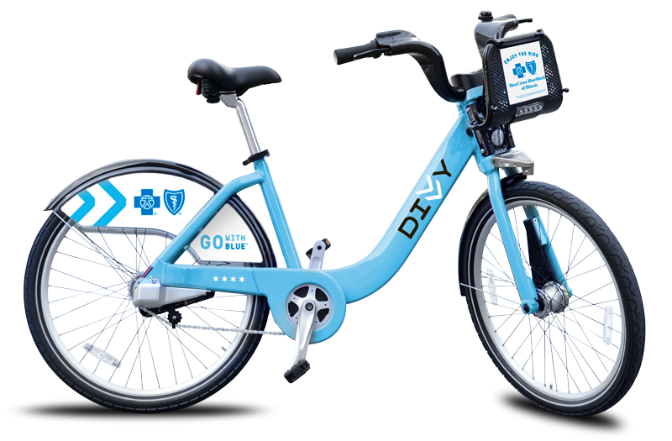
Introduction and Problem Statement
Divvy Bikes
Chicago’s bike share system
Over 6,000 bikes
Over 250 stations
Program of Chicago Department of Transportation
Yearly Net Profit
2014: $2,860,000
2015: $2,840,000
2016: $1,970,000
Problem Statement
The Mayor of Chicago wants to understand Divvy Bikes ridership with key visualizations and a model to predict trip duration based on start location station and end location station.
Key visualizations:
Top 5 stations based on # of starts
Trip duration by user type
Most popular trips
Rider performance
Busiest bike

Slide 4
Methods
Data Source
Divvy Bikes 2017 usage
Divvy Bikes pricing
Data Cleaning
Excel
Exclude rows missing critical variables
Add starting and ending station longitude and latitude to each row
Calculate distance between starting and ending station for each row
Calculate average speed for each row
Python
Exclude rides less than 1 minute (riders who change their minds) or greater than 3 hours (lost/abandoned/stolen bikes)
Looking at the pricing data shows the Explorer riders ride up to 3 hours, afterwards all memberships get very expensive
Exclude riders with potentially falsified ages
Under 10 and over 75
Analysis
Visualizations and predictive modeling done in Python via Jupyter Notebook

Slide 5
Exploratory Analysis
Shape
Rows: 3,829,003
Columns: 16
Early analysis shows us that the data is very skewed to the right, as we would expect, shorter trips are much more popular than longer trips
Trip Duration per User Type (before implementing time constraints)
Trip Duration per User Type (after implementing time constraints)

Slide 6
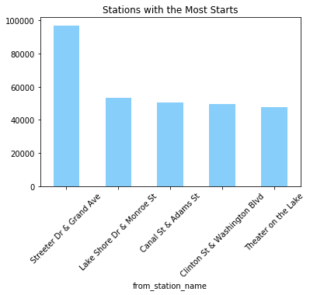
Most Popular Stations
Station Rank | Station Name | Number of Starts
1 | Streeter Dr. & Grand Ave. | 97,070
2 | Lake Shore Dr. & Monroe St. | 53,132
3 | Canal St. & Adams St. | 50,574
4 | Clinton St. & Washington Blvd. | 49,542
5 | Theater on the Lake | 47,627
Pictured left: Navy Pier, a popular tourist destination close to Streeter Dr. & Grand Ave that could explain the station’s popularity

Slide 7
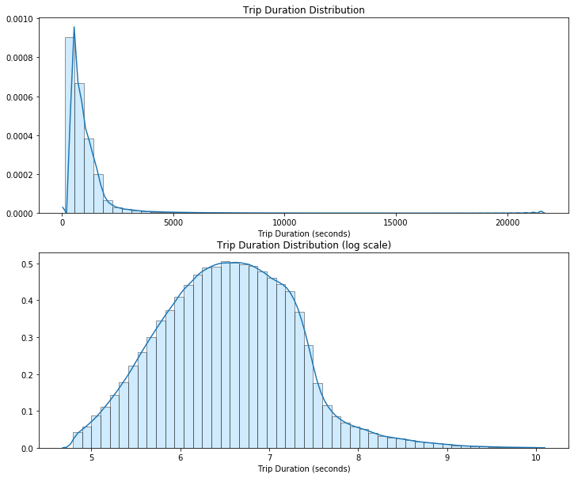
Average Trip Duration
Average Trip Duration
As hypothesized, average trip duration is skewed right, showing riders typically take shorter rides

Slide 8
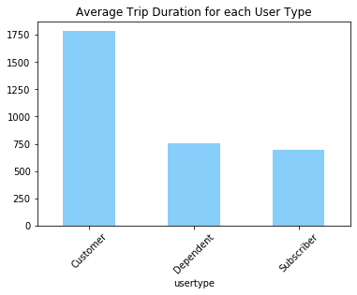
Average Trip Duration cont.
Number of Average Trip Duration by User Type
Number of Starts per User Type
Subscribers’ average trip lasts 9.62 minutes
Customers’ average trip lasts 14.96 minutes
Dependents’ average trip lasts 12.53 minutes
Subscribers take the most rides, they also receive the best price per ride

Slide 9
Most Popular Trips
Station Rank | Start Station Name | End Station Name | Number of Starts
1 | Lake Shore Dr. & Monroe St. | Streeter Dr. & Grand Ave. | 12,170
2 | Streeter Dr. & Grand Ave. | Streeter Dr. & Grand Ave. | 9,611
3 | Streeter Dr. & Grand Ave. | Theater on the Lake | 8,180
4 | Streeter Dr. & Grand Ave. | Lake Shore Dr. & North Blvd. | 7,992
5 | Lake Shore Dr. & North Blvd. | Streeter Dr. & Grand Ave. | 7,225
6 | Streeter Dr. & Grand Ave. | Lake Shore Dr. & Monroe St. | 7,190
7 | Theater on the Lake | Streeter Dr. & Grand Ave. | 7,048
8 | Lake Shore Dr. & Monroe St. | Lake Shore Dr. & Monroe St. | 5,217
9 | Streeter Dr. & Grand Ave. | Michigan Ave. & Oak St. | 4,760
10 | Streeter Dr. & Grand Ave. | Millennium Park | 4,260

Slide 10
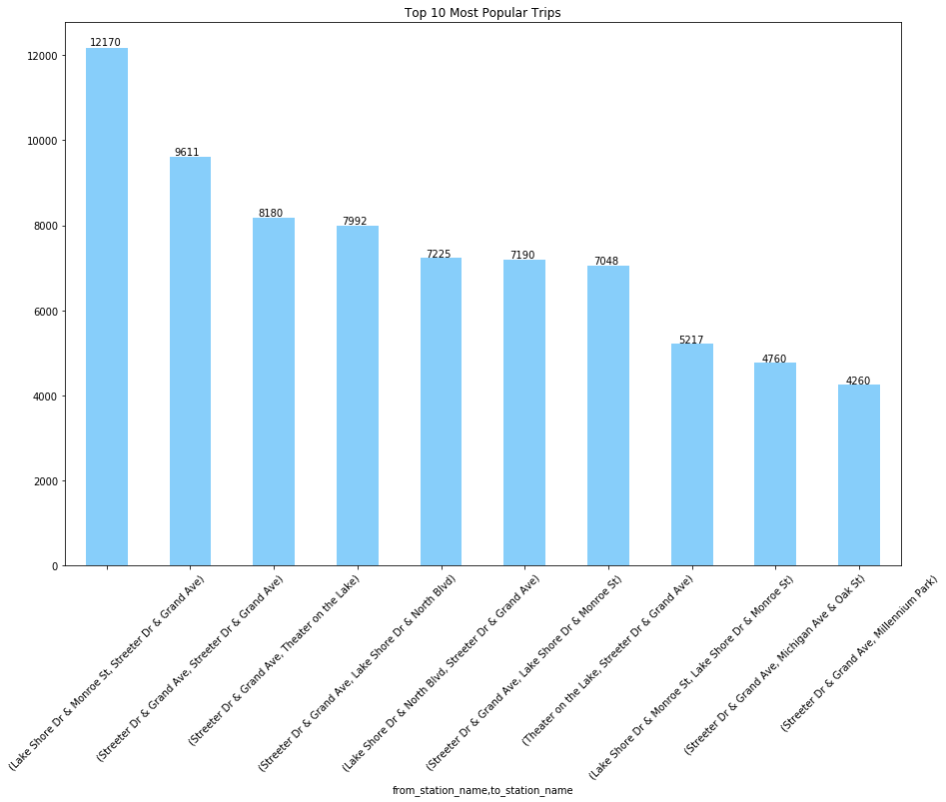
Most Popular Trips cont.
Streeter Dr. & Grand Ave. is a common occurrence in these routes because it is the most common station to start from. Lake Shore Dr. & Monroe St. to Streeter Dr. & Grand Ave. may be such a popular trip because it is short (only about a mile directly) and passes through many parks (including the famous Millennium Park and Grant Park) while riding next to the scenic Lake Michigan.

Slide 11
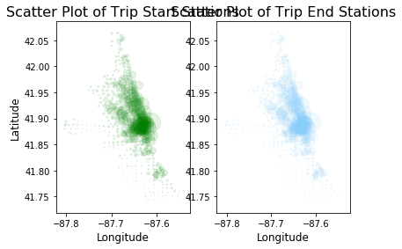
Most Popular Trips cont.
Scatter Plot of Start Stations | Scatter Plot of End Stations
As expected, most popular start stations are mimic most popular end stations. The bikes are not usually moved to a different station without a rider. The preferred stations are centered around “the loop” or Navy Pier, which is downtown Chicago. The border to the right is Lake Chicago, the rides may be heavier to the east because biking on the lake is attractive to many bikers.

Slide 12
Rider Performance
Important Formulas
Spherical Law of Cosines for Distance
Speed
Younger riders typically ride at a slightly faster pace than older riders with median speed peaking in the 25-35 age group. Men average faster speeds than females of the same age.
Average Trip Duration by Age and Gender
On average, females ride for longer.
Average Speed by Age and Gender

Slide 13
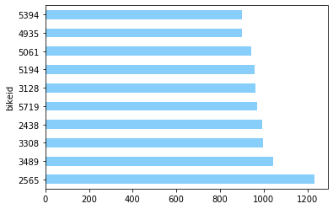
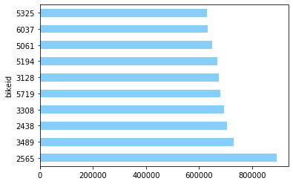
Busiest Bike
Top 10 Bikes by # of Starts
Top 10 Bikes by Time Ridden (seconds)
There are two ways to determine the busiest bike in Chicago, number of trips taken and number of seconds used. Fortunately, the busiest bike is consistent by both standards.
This suggests positive correlation between number of starts per bike and seconds ridden per bike.

Slide 14
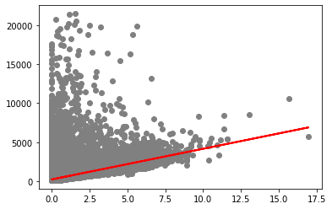
Simple Linear Regression
Predicting trip duration based on distance between start and end stations.
An R² of .4573 means the model explains 45.73% of the variability of the response around the mean.
ŷ = 225.07 + (392.89 * x)

Slide 15
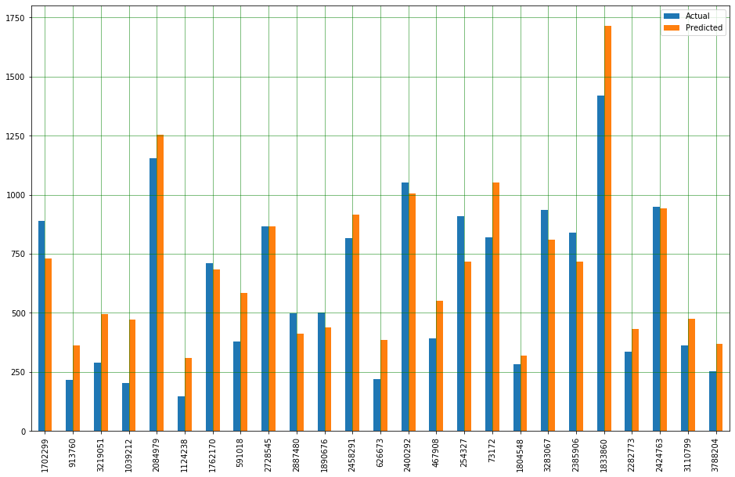
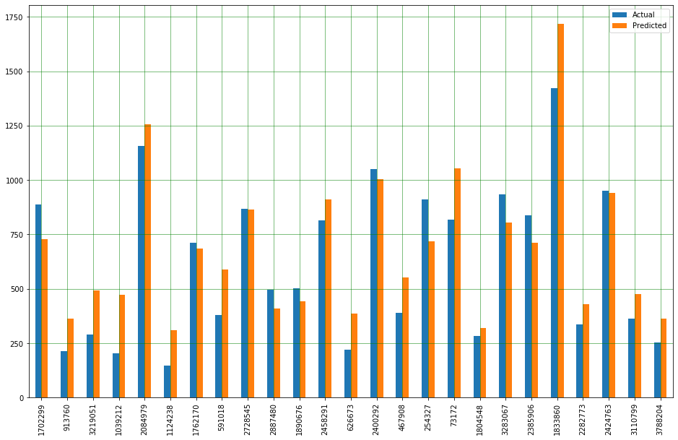
Multiple Linear Regression
This model used distance traveled, gender, user type, start station, and age to predict trip duration.
An R² of .4622 shows this model performed incrementally better than the multiple linear regression without start station.
This model used distance traveled, gender, user type, and age to predict trip duration.
An R² of .4621 shows this model performed only slightly better than the simple linear regression model.

Slide 16
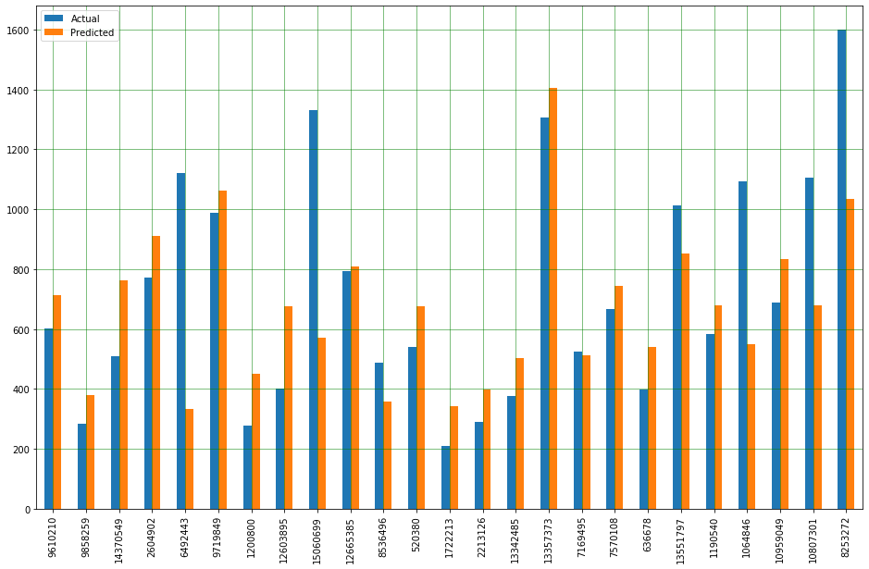
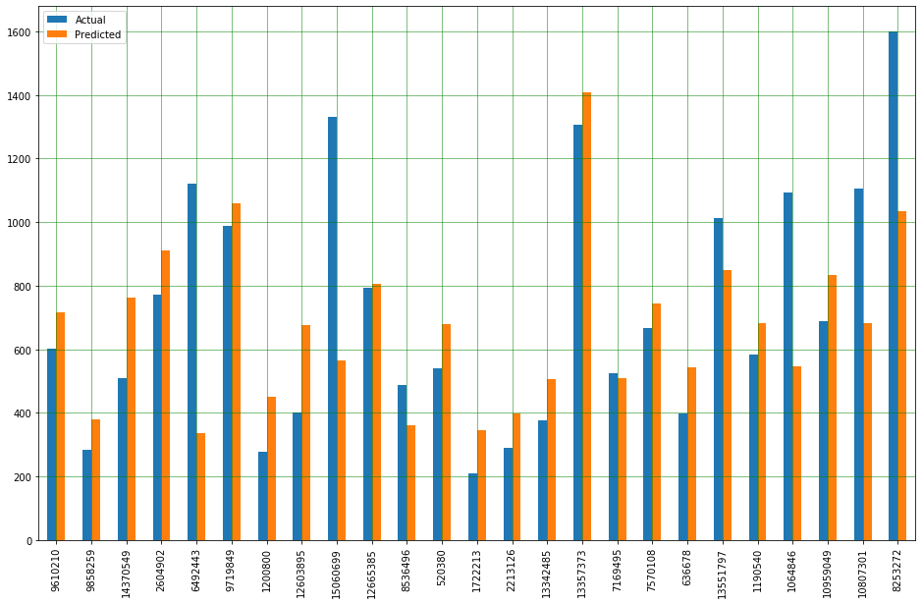
Multiple Linear Regression
Customers who enter their start and end stations have clear destinations and routes in mind. Therefore, we can clean the data more and refine the multiple linear regression model:
This model used distance traveled, gender, user type, start station, and age to predict trip duration.
Refinement
An R² of .4569 shows this model performed incrementally better than the multiple linear regression without start station.
Result
Drop rides greater than 3 hours. The longest route station to station is 27.8 miles, but the average distance ridden is only 1.2 miles.
R² increases to .5370, MSE decreases from 176.87to 173.51
This model used distance traveled, gender, user type, and age to predict trip duration.
Drop rides greater than 2 hours and rides further than 10 miles.
R² increases to .5702, MSE decreases to 171.62
An R² of .4568 shows this model performed only slightly better than the simple linear regression model.

Slide 17
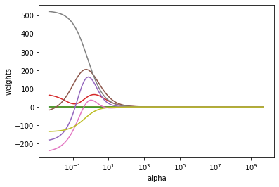
Ridge Regression
Plotting the alphas to determine which results in the smallest cross validation
In the first iteration of Ridge Regression where alpha is set to 1, we get an R² of .3395, but after optimizing alpha to be .005, we get an R² of .6686, which is a large improvement compared to our other models.

Slide 18
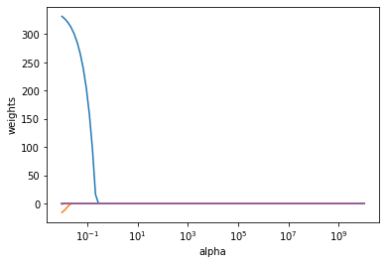
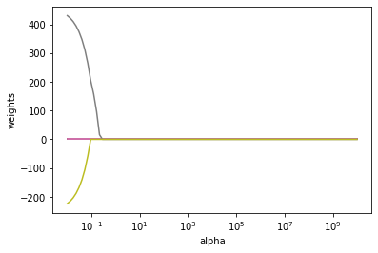
Lasso
Coefficient Plots
After performing Lasso on several different iterations of the cleaned data, the highest performance comes from the data where distances over 20 miles have been dropped, and trip duration is less than two hours.
The highest performing Lasso model results in an R² of .7993, exceeding the results of all the other models.

Slide 19
Conclusions and Next Steps
Conclusions:
The most popular trip is from Lake Shore Dr. & Monroe St. to Streeter Dr. & Grand Ave.
The busiest bike is bike 2565
80% of the variation in trip duration can be explained by the Lasso model
Future Recommendations:
Add in other datasets such as weather, traffic patterns, and holidays
Use data from the GPS’ on the bikes to make distance traveled more accurate
Explore other modeling techniques (Facebook Prophet, ARIMA, etc.)
IBM Confidential

